Slide 1
Name-Bayana Aishwarya
Work Done-
Designed a responsive and user-friendly frontend using React and Tailwind CSS for structured data entry and display.
Implemented a validated employee registration form to ensure accurate and complete data submission.
Developed dynamic Directory → Division relational mapping, where division options automatically update based on the selected directory.
Integrated full CRUD operations (Create, Read, Update, Delete) between frontend and backend using REST APIs.
Added export functionality to download employee records in PDF and Excel formats for reporting purposes.
Built the backend using Spring Boot with layered architecture (Controller, Service, Repository) to handle business logic and API communication.
Connected the application to Oracle Database, creating Employee, Directory, and Division tables with proper relational mapping.
Integrated Grafana dashboards using the Marcus Olsson JSON Data Source plugin to visualize employee statistics in graphical format.
Implemented token-based API security (Bearer Authorization) to protect backend endpoints and ensure controlled data access.

Slide 2
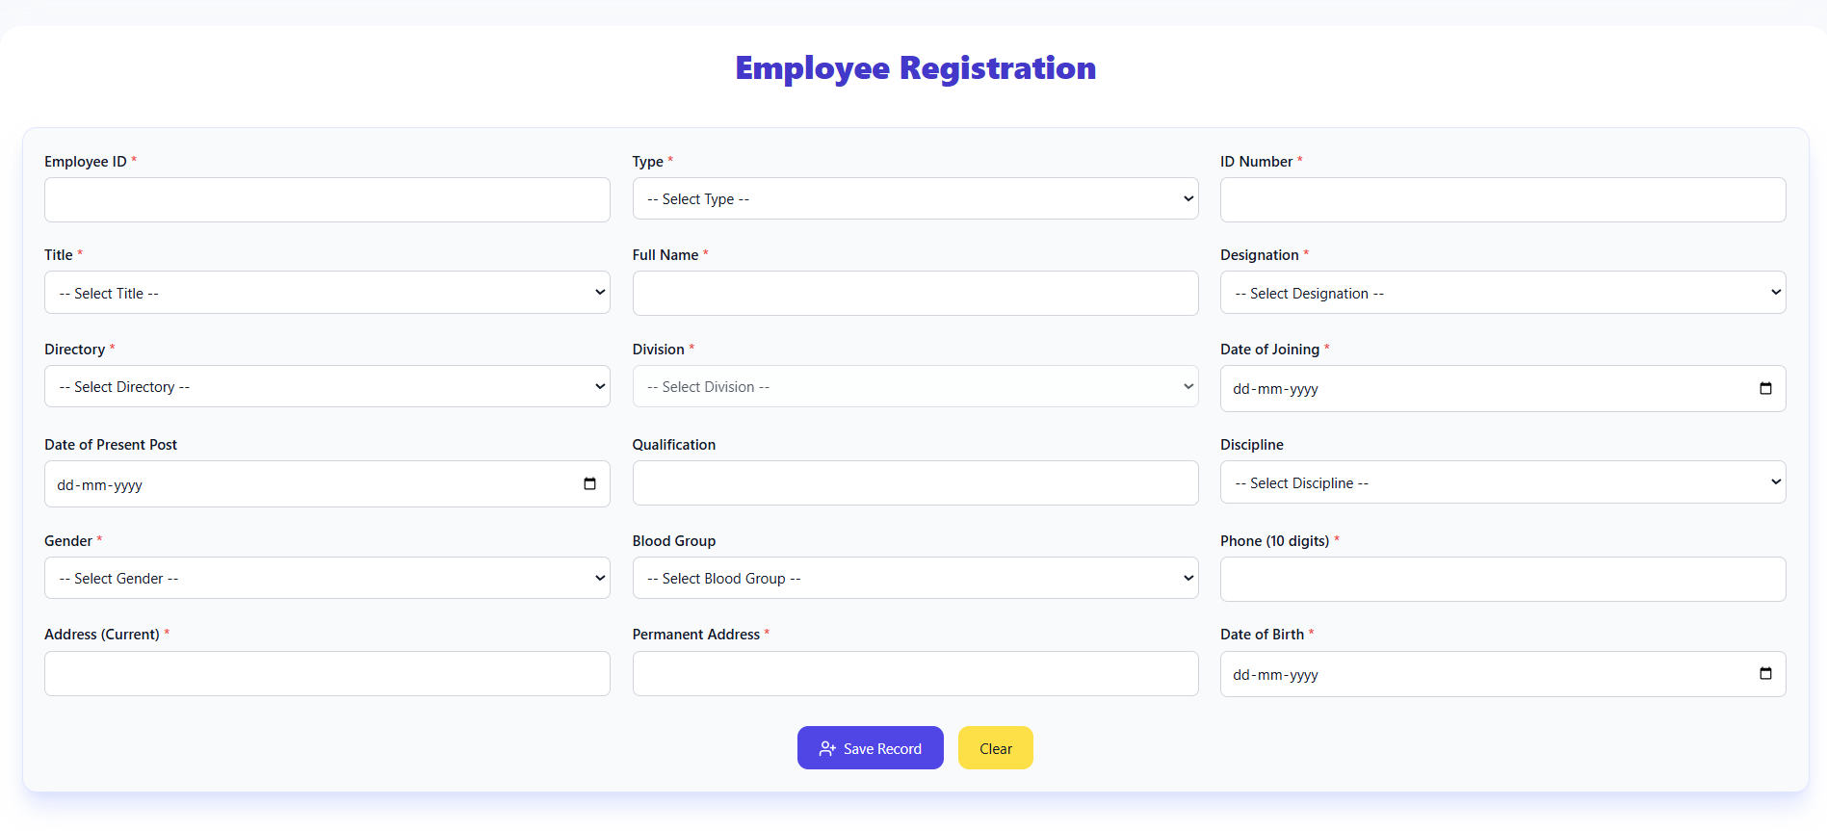

Slide 3
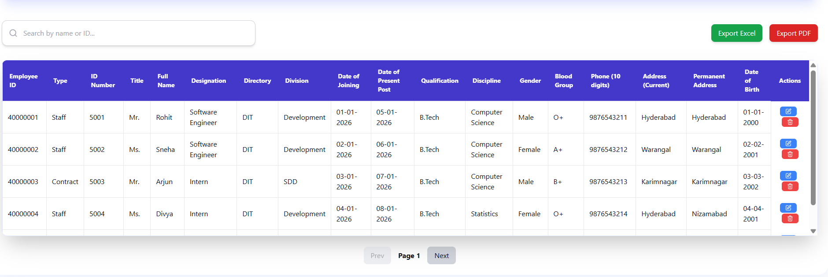

Slide 4
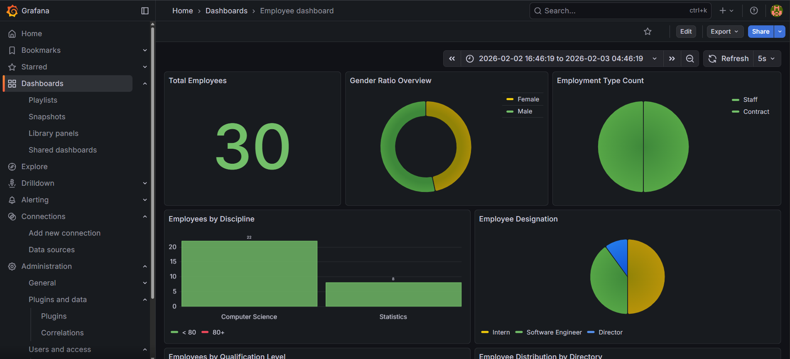

Slide 5
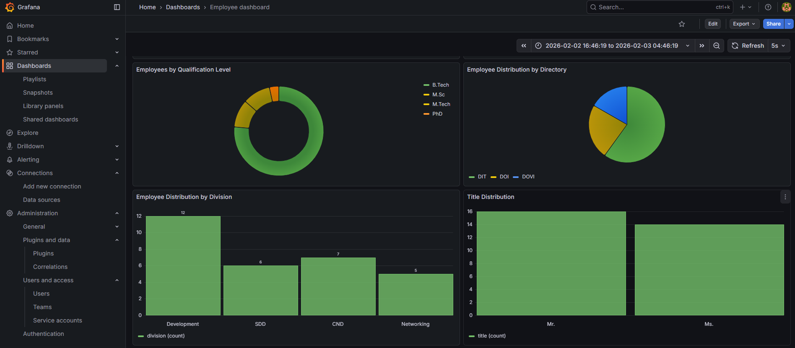

Slide 6
